Slide 1
Minds, Machines, and Persons
Philosophical Methodology and Argumentation

Slide 2
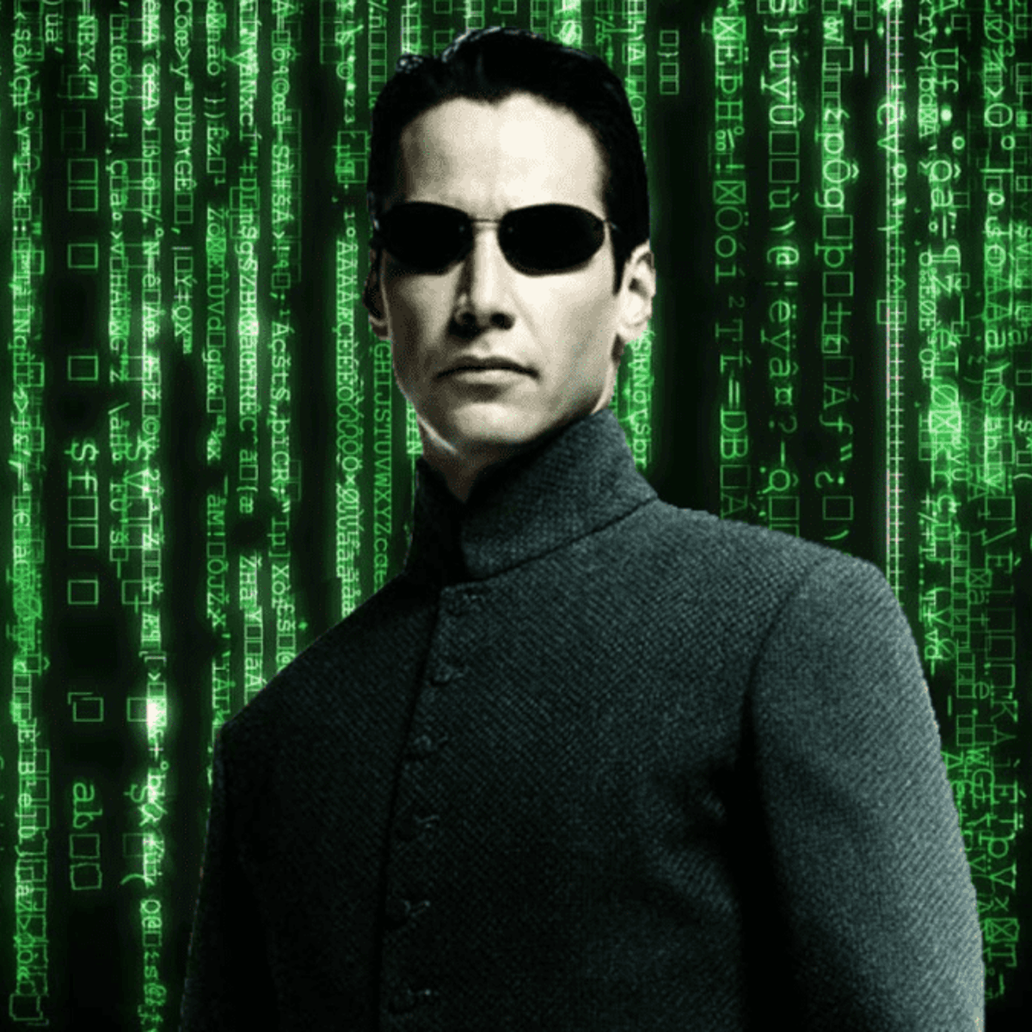
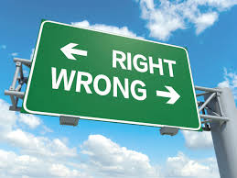
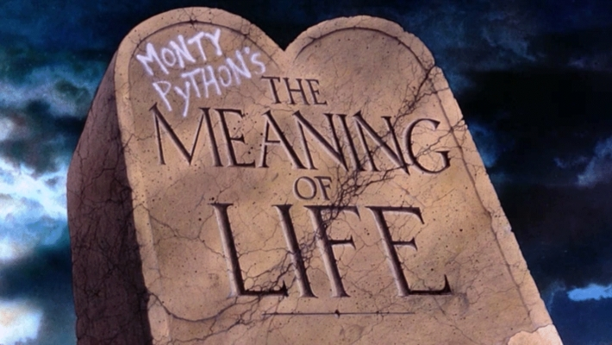
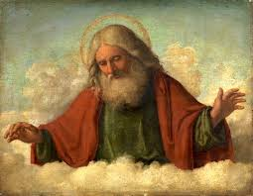
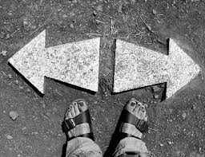
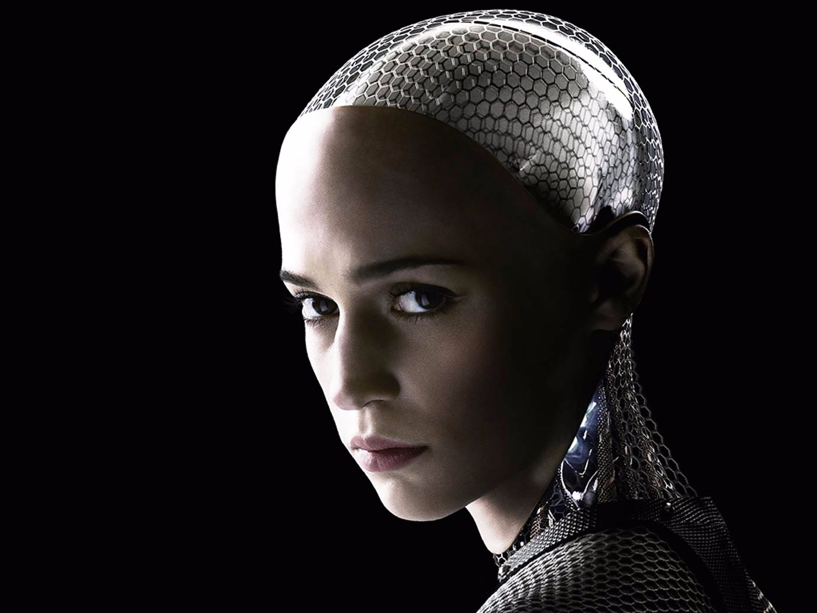

Major areas of philosophy
Epistemology
Metaphysics
Ethics
What can we know?
What should we do?
Logic
What is there?
Notes:
Philosophical questions come in three basic forms. Epistemology deals with questions pertaining to the formation of knowledge. What do we know, how do we know it? Ethics deals with determining what is right and wrong. And metaphysics deals with questions about reality and what kinds of things exist. Logic can be thought of a set of rules that govern rational thought. Logic lays down the basic ground rules for philosophical theorizing. We will go more into logic and argumentation next class. We will now spend some time discussing issues in each of these three main sub-branches of philosophy. Introduce each with an example. If no I-clickers on day 1, you can do the votes by show of hands.

Slide 3
Overview
What are the methods of philosophy? How are they different from the methods of science and other disciplines? To what extent are they shared across disciplines?
1) Basic terminology
2) Conceptual analysis and defining terms
3) Logic and argumentation
4) Thought experiments

Slide 4
Concepts for philosophical reasoning
Truth
Argument
Belief
Notes:
The truth value of determinate statements do not ever change. If we were wrong about what the facts were, then it would be our beliefs that change, not the facts.
one party can be right! (see law of noncontradiction)

Slide 5
Truth
Most philosophers hold the following view about the nature of truth:
A statement or proposition is true when it corresponds with reality (how the world really is)
Correspondence theory of truth
Truth is not relative to what some individual or group believes
Truth is independent of feelings, opinions, or beliefs
Opinions or beliefs can be mistaken
Fact- A true statement (or proposition).
Disagreeing about what the facts are
No such thing as “alternative facts”
People have different beliefs

Slide 6
Beliefs
Beliefs are mental states of individuals
Accepting that a proposition is true
Beliefs can be about anything (not just religion)
I believe that: 2+2=4, the Earth is round, I’m in NJ
Like propositions, our beliefs can be true or false
Notes:
Beliefs can be about any matter of fact, even uncontroversial ones (e.g. I believe I have a hand, 2+2=4, etc.).
E.g. I falsely believed that I locked my front door this morning.

Slide 7
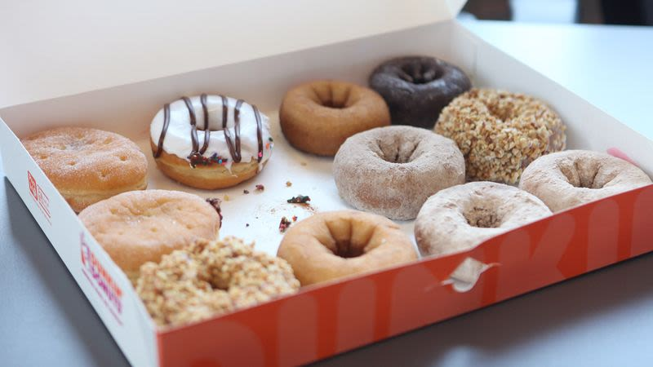

Beliefs
Easy case: How many donuts are there?
✔
I believe there are 12 donuts
I believe there are 11 donuts
TRUE BELIEF
FALSE BELIEF
TOM
11 donuts in the box
JERRY

Slide 8
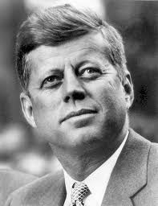
Harder case: the JFK assassination
Belief 1: Kennedy was shot by Oswald alone
Belief 2: Kennedy was shot by Oswald and someone else
Belief 3: Kennedy wasn’t shot by Oswald, but by some unknown group of conspirators
Which belief is true?
Fact of the matter who is right, even if we don’t know which

Slide 9
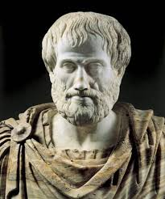
Ground rule for reasoning: the law of noncontradiction
Law of non-contradiction: No proposition is both true and false (in the same sense and at the same time).
Take-home message: When it comes to matters of fact, we cannot all be right.
No contradictions allowed!
Notes:
E.g. Even or odd number of stars in the universe
E.g. True that Trump is bald, and false that Trump is bald (at the same time).

Slide 10
Illustration
Metaphysical proposition: God exists
Theist believes that God exists
Atheist believes that God does not exist
LON entails that atheists and theists cannot both be right with respect to the existence of God
Either the theist is correct (God exists is true) or the atheist is correct (God exists is false)
Common confusion: We don’t know whether the God proposition is true or false, therefore there is no truth about God
Failure to distinguish between claims about reality (metaphysics) and human knowledge/ignorance (epistemology)
Reality might consist of things beyond what we can know or understand
God exists is either true or false, whether or not we can know it

Slide 11
Philosophical Methods
How do philosophers decide whether philosophical theses are true?
1) Conceptual analysis
2) Logical arguments
3) Thought experiments

Slide 12
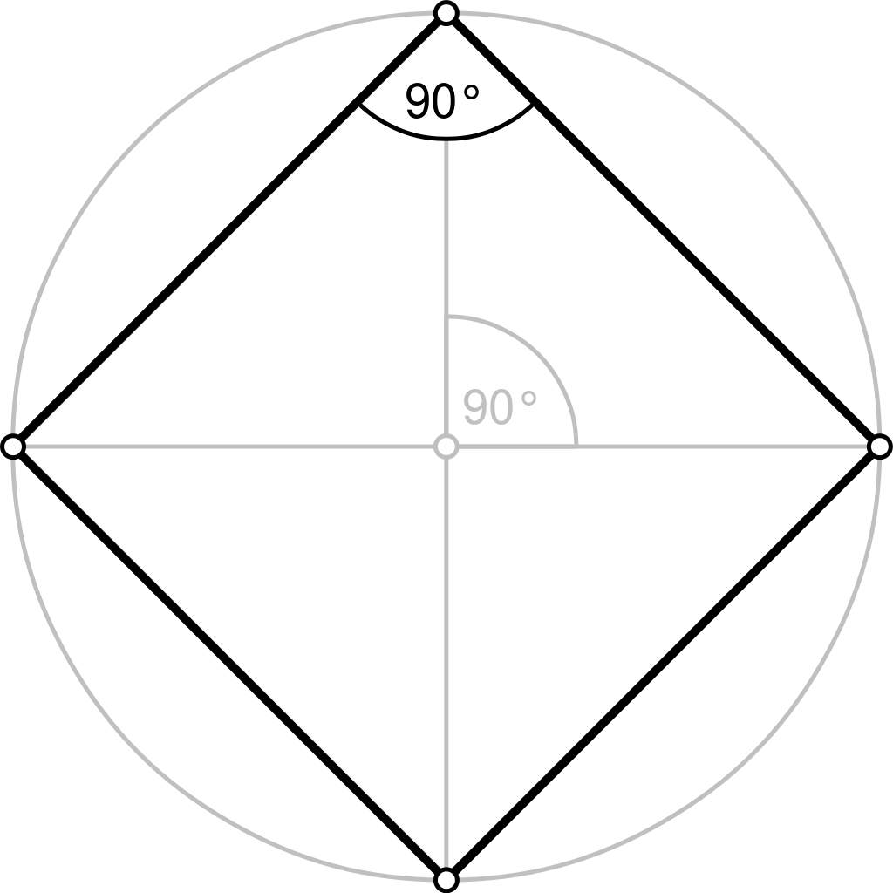
Conceptual analysis
Perhaps the oldest method in philosophy
Meaning of terms: What is X?
What is the essence of X? (e.g. What is a mind? What is knowledge? What is a square?)
Looking more than examples or a dictionary definition
Definition in terms of necessary and sufficient conditions*
What exactly is required for something to be an instance of X?
Illustration (geometry): What is required for something to be a square?
4 equal sides
4 equal right angles
These features are the essence of squarehood
All squares have these features
No non-squares have these features
Notes:
What is the essence of a square? Necessarily 4-sided, but not sufficient (rectangle, rhombus). 4 equal length sides, 4 right angles
What is required to be POTUS? Necessarily natural born citizen, 14 years of residency, at least 35 years old. Are these sufficient to be president? No! Must also win a general election and be inaugurated.
In discussion last time, there were several proposed conditions for having a mind. One was having a brain or complex nervous system. We can ask whether this is a necessary condition, or merely a sufficient condition. Question: Could there be entities that have minds that lack brains? (digital computers, God)

Slide 13
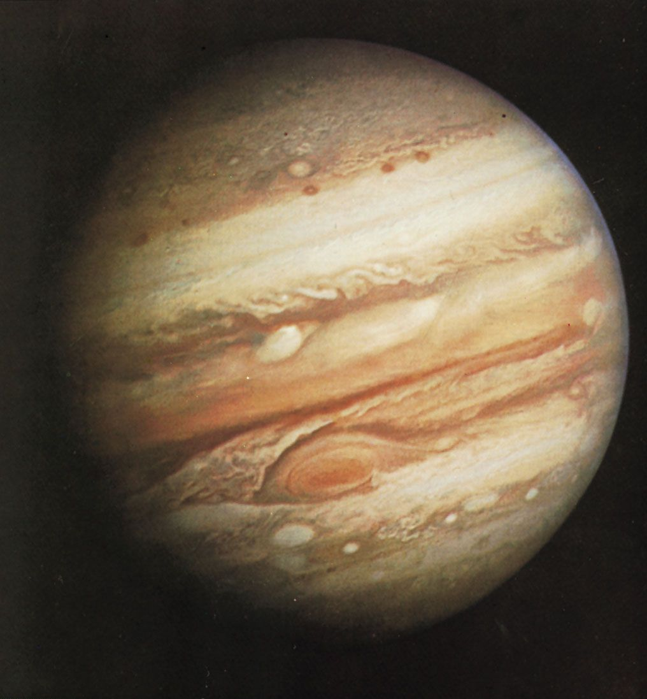
What is knowledge?
Suppose Tom claims to know that p
p= Jupiter has over seventy moons
What must be true for Tom to have this knowledge?
Necessary conditions?
1) p must be true
2) Tom must believe p
must have some confidence that p is true
True belief is not sufficient for knowledge
The case of accidentally true beliefs
Takeaway: Definition of knowledge requires some extra ingredient(s)
Epistemologists disagree about what those are (e.g. justification, belief formed via a reliable process)

Slide 14
Arguments
Argument- a series of statements, reasons, or claims that lead to a conclusion.
Not a heated dispute
An attempt to justify some position or claim by rational means
Two ingredients: Premises—the supporting statements—and a conclusion
Premises explain why we should accept the conclusion
Philosophers use arguments to defend philosophical theses
Cannot just assert that a position is true

Slide 15
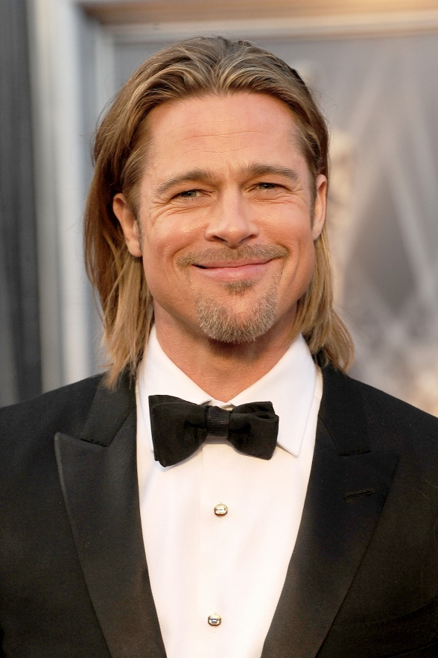
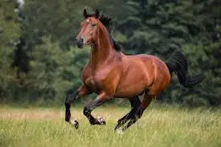
Evaluating arguments
Two ways to determine whether an argument is good
1) The logical relationship between premises and conclusion
Do the premises (if true) demonstrate that the conclusion is true?
2) The truth values of the premises and the conclusion
Are the premises and conclusion statement true?
P1. All horses have four legs
P2. Brad Pitt is a horse
C. Therefore, Brad Pitt has four legs

Slide 16
Two ways an argument can go wrong
1) Bad structure
The conclusion doesn’t follow from the premises
The conclusion isn’t likely to be true, given the truth of the premises
2) False or unlikely premises
Factual errors
Statements backed by little to no evidence

Slide 17
Deductive arguments
Philosophers tend to construct deductive arguments to support their claims
Aim of a deductive argument is to prove a conclusion
Two features of a good deductive argument: Validity and Soundness
For an argument to be valid, its conclusion has to necessarily follow from the truth of its premises
If premises are true, the conclusion must be true
Impossible for the conclusion to be false (violation of laws of logic)
Validity refers to logical structure of an argument, not its content
Valid arguments do not have to be plausible or have true premises or a true conclusion (philosophers use ‘validity’ in a technical sense)
Best to ignore the content entirely
Notes:
Validity is a technical term in the study of logic. It doesn’t carry the same meaning as in everyday English. Arguments can not be true or false. It is the statements themselves that are true or false.

Slide 18
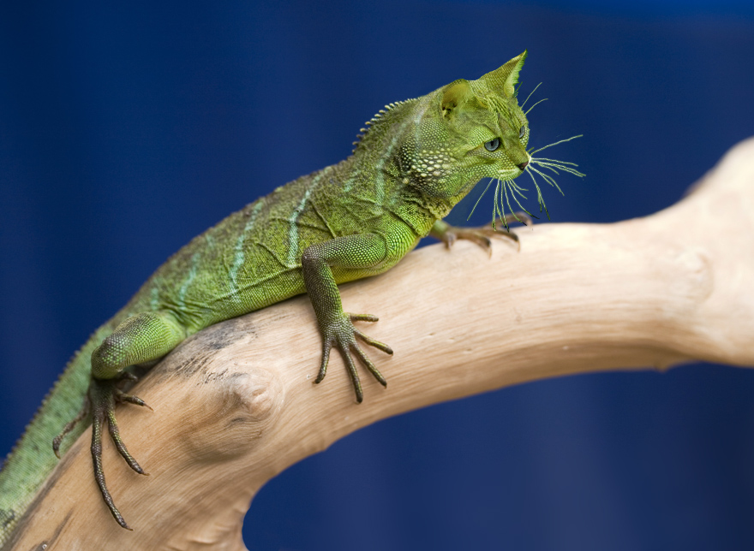
P1. All cats are reptiles
P2. Barry is a cat
C. Barry is a reptile
Is this a valid argument?
Notes:
Valid argument

Slide 19
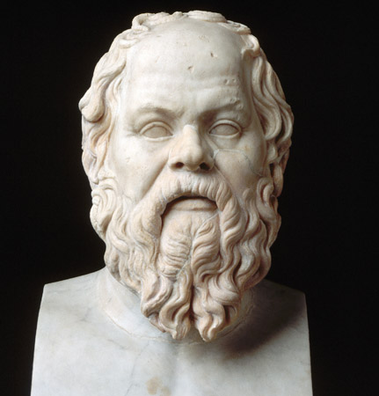
Two valid arguments
P1. All cats are reptiles
P2. Barry is a cat
C. Barry is a reptile
P1. All men are mortal
P2. Socrates is a man
C. Socrates is mortal

Slide 20
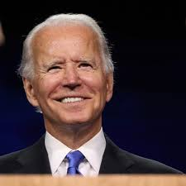
P1. All Presidents reside at the White House
P2. Joe Biden resides at the White House
C. Joe Biden is a President
Is this a logically valid argument?
Notes:
Belief bias: tendency to believe arguments are valid because they have true conclusions (reliant on system 1)

Slide 21
Testing for validity
The argument gives us two pieces of information
1) Presidents reside at the White House
2) Joe Biden is a person who resides there
Question: Given this information, is it logically possible for someone to reside at the White House and not be President?
Answer: Yes!
The argument is not “watertight”, hence invalid

Slide 22
Validity
If valid, there’s no way the conclusion can be false if the premises are true
Slogan: Truth in=Truth out
If an argument is valid, but you know the conclusion to be false, one of the premises must be false.
In logic, validity has a specific meaning
Not the same as how it’s used in ordinary speech

Slide 23
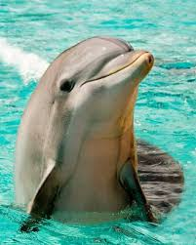
Soundness
Sound arguments are valid with true premises (premises are facts).
Unsound arguments fail one or both tests (could be invalid or have false premises)
We’d like our arguments to be not only valid, but also sound.
E.g.
P1. All mammals have mammary glands
P2. Dolphins are mammals
C. Dolphins have mammary glands

Slide 24
Recognizing argument forms
It can be helpful to memorize the forms (or patterns) of valid arguments
Philosophers often formulate their arguments using one of the following valid forms:
Modus Ponens
Modus Tollens
Disjunctive Syllogism

Slide 25
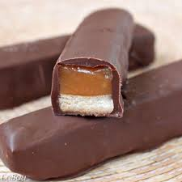
Valid argument form #1
Modus Ponens: P→Q, P : Q
P1. If P then Q
P2. P
C. Q
P1. If this candy bar has trans fat, then it is unhealthy.
P2. This candy bar has trans fat.
C. Therefore, this candy bar is unhealthy.
Notes:
Disjunctive syllogism (Dilemma): P v Q, ~P : Q
Hypothetical syllogism: P→Q, Q→R : P→R
Logical variables: plug and play any propositions you’d like and they’ll be valid.

Slide 26

Valid argument #2
Modus Tollens: P→Q, ~Q : ~P
P1. If P then Q
P2. Not Q (Q is false)
C. Not P (P is false)
P1. If it rained this morning, the field would be wet
P2. The field is not wet
C. It didn’t rain this morning

Slide 27
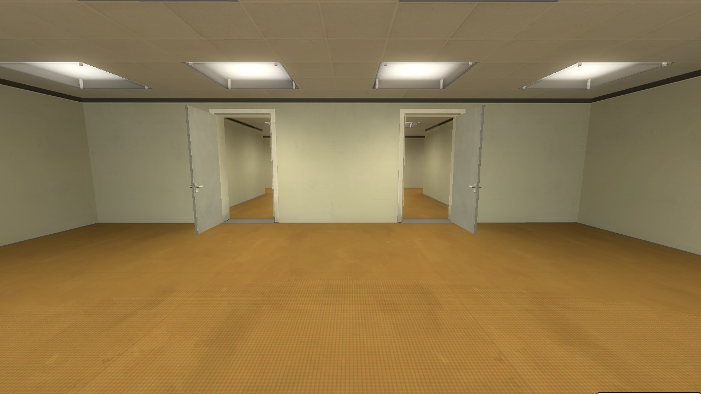
Valid argument form 3
Disjunctive Syllogism: P v Q; ~P : Q
P1. Either you entered the left door or the right door
P2. You did not enter the left door
C. You entered the right door
If the disjunctive claim is true, then there are only two options
If it’s not one option, it’s the other

Slide 28
Other kinds of arguments
Deductive arguments are intended to provide reasons that render the conclusion certain
Valid arguments
Inductive arguments are invalid, but intended to provide reasons that render the conclusion probable
Not all invalid arguments are bad
There are names for some of the bad ones; fallacies
Conditional support comes in degrees (deductive support is binary valid/invalid)
Evaluated in terms of strength
Outside of philosophy, we tend to use inductive arguments

Slide 29
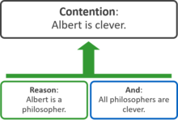
Ways of representing arguments
Standard form
Argument mapping
P1. Albert is a philosopher
P2. All philosophers are clever
C. Albert is clever

Slide 30
Thought experiments
Philosophers often use thought experiments to test philosophical theories and conceptual analyses
Thought experiment- a hypothetical scenario used to elicit judgments or intuitions
Functions of thought experiments:
Exploratory function
To understand which “side” you are on
Test for theories, definitions, and principles
May serve as an objection or as support
Argument from analogy
Hypothetical scenario is analogous to scenario in the real world

Slide 31

The Swampman
Suppose Donald goes hiking in the swamp and is struck and killed by a lightning bolt; at the same time, in the nearby swamp another lightning bolt spontaneously rearranges a bunch of molecules such that, entirely by coincidence, they take on exactly the same form that Donald’s body had at the moment of his untimely death. This being, whom we shall call “Swampman,” has, of course, a brain which is structurally identical to that which Donald had, and will thus, presumably, behave exactly as Donald would have. He will walk out of the swamp, return to Donald’s office at Berkeley, and write the same essays he would have written; interacting like an amicable person with all of Donald’s friends and family, and so forth.
Would Swampman have a mind with all of the same thoughts Donald would have had?
Are Donald and Swampman the same person?

Slide 32
Thought experiments
Usually science fiction (wildly unrealistic or physically impossible)
Objection: How could science fiction be relevant to the real world?
Response: Hypothetical syllogism as a valid form of inference
Doesn’t matter how unrealistic it is
Illustrates the implications of philosophical theories
Highly idealized case: removal of all distractors so that the philosophically relevant factors can be closely examined
Philosopher’s version of a controlled study

